Slide 1

Yelp Dataset Challenge
Angela Truong
Data Science Project: Monday August 24, 2015

Slide 2
Premise
Original project: Best tacos in the bay area
Signed up for Yelp API key:
Limited data available from Yelp API
API only allows one review to be pulled from a business
Yelp is currently not providing special academic research access.

Slide 3

Prepared data available
With difficulty grabbing data, I was suggested to go with the Yelp Dataset Challenge. Thank you Ramesh!

Slide 4
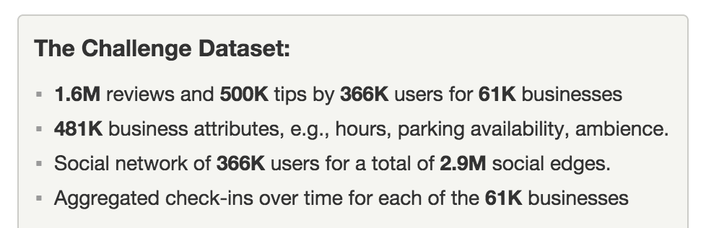
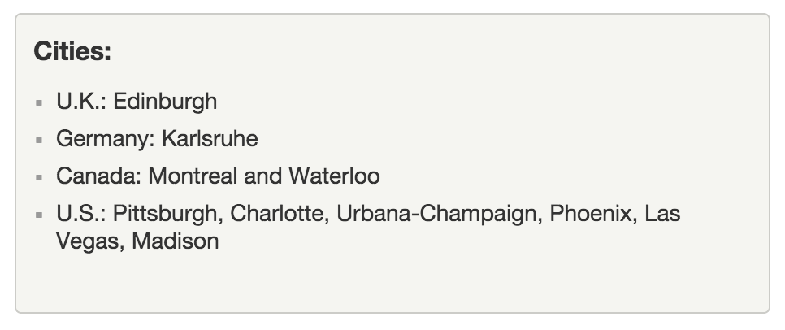
Yelp Dataset

Slide 5
Where to start:
Yelp provided sample questions to get challengers started on what to look for in their provided dataset.
Yelp was very open to any conclusions challengers can reveal.
Attempt to answer their Natural Language Processing questions.

Slide 6
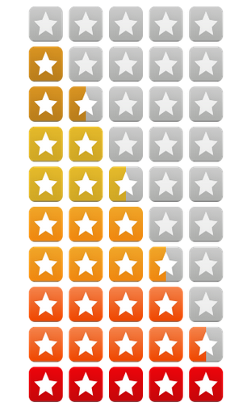
NLP Questions:
How well can you guess a review’s rating from its text alone?
What are the most common positive and negative words used in our reviews?

Slide 7
Yelp Dataset Challenge provided data in json format
Review
Business
User
Check-in
Tip

Slide 8
Yelp Dataset clean up:
Review (randomly selected 200K rows, dumped all non-English reviews and used as main dataset for NLP)
Business (filter for Las Vegas locations)
User (filter for creditable users: Elite status for at least 5 years and has written over 100 reviews)
Check-in (Did not use)
Tip (Did not use)
Ended up with over 8K rows when merged together

Slide 9
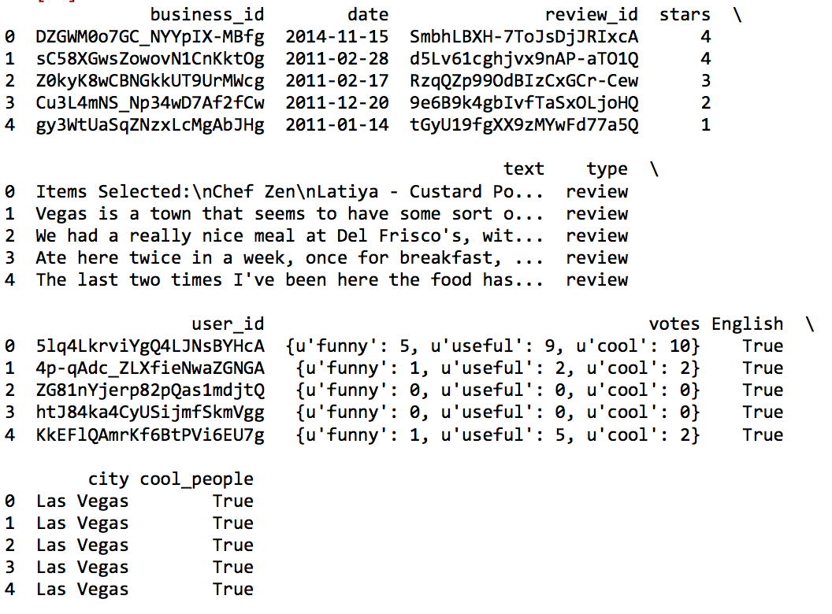
Dataset: yelpdata.header(5)

Slide 10
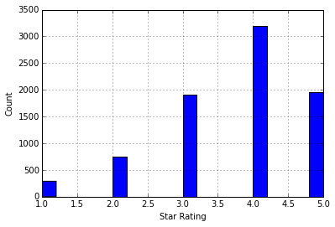
Visualize Dataset

Slide 11
How well can you guess a review’s rating from its text alone?
First approach with Sentiment Polarity
Added this as a new feature for the dataframe
Naives Bayes classifier using sklearn
Split into training and testing sets

Slide 12
Sentiment Analysis: Polarity
The scores for each review was not a good way to predict the star rating.
Long reviews threw out unpredictable scoring.
There were many negative scores for four-star ratings.
Conclude: Move on to another method.

Slide 13
Predictive Model
Text data
Train Test Split Model
Count Vectorizer 50% or TfidfVectorizer 40%
Turn into Matrix
MultinomialNB
Probability

Slide 14
What are the most common positive and negative words used in our reviews?
Used nltk
Tokenization
Chain
http://www.cs.uic.edu/~liub/FBS/sentiment-analysis.html#lexicon (source: Negative and positive dictionary with 6800 words)
Word Cloud

Slide 15
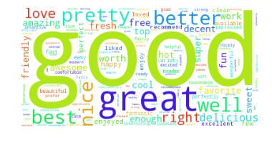
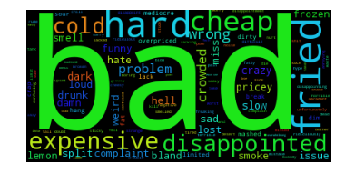
WordCloud for most common positive and negative words in reviews. Can you guess which is which?

Slide 16
Conclusion and Key Learnings:
There is a lot of data cleaning.
Had to create a lot of functions.
Do not focus too long on data. But just enough.
Do not always picture excel when dealing with dataframes.
Sentiment polarity could’ve been done a better way.
Find better ways to classify positive and negative words. There are better approaches out there.

